Slide 1
Task 5-Software Configuration Management
Nur Syafiqah binti Zulkifli(193575)(TASK LEADER)
Sufi Nukman bin Shakimi(194092)
Siti Nur Syahirah binti Mohd Ashri(193578)
Muhammad Harith bin Zainudin(192171)
Muhammad Amir Hassan bin Hamzan(193577)

Slide 2
Introduction
- Software Configuration Management is a set of activities used to manage changes in software throughout the software life cycle.

Slide 3
Purpose
To identify changes in the attendance system using fingerprint approach using The Change Compass tool.
To control the changes in the attendance system using fingerprint approach.
To produce reports about the changes made on the system.

Slide 4

Tools used: The Change Compass
A web based application
Help user to initiate changes
Produce meaningful reports
Helps user in decision making

Slide 5
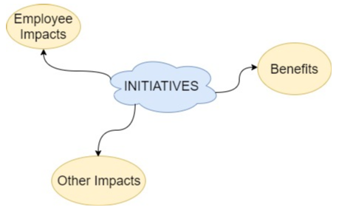
Features and Functions
INITIATIVES

Slide 6
Initiatives
Data Backup
Budget Tracking

Slide 7
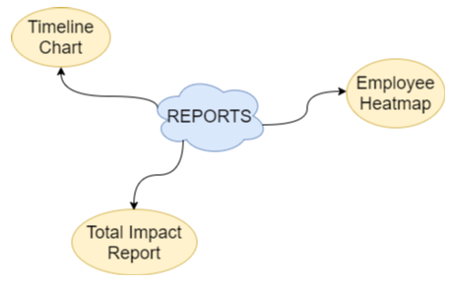
2) REPORTS

Slide 8
THE CHANGE COMPASS DEMO

